Slide 1
Newton’s Backward Interpolation & Lagrange's Interpolation Formula
Course Instructor
Engr. Rahemeen
Rahemeen.bukc@bahria.edu.pk

Slide 2
Interpolation
Forward
Interpolation is the technique of estimating the value of a function for any intermediate value of the independent variable, while the process of computing the value of the function outside the given range is called extrapolation.
Differences: The differences y1 – y0, y2 – y1, y3 – y2, ……, yn – yn–1 when denoted by dy0, dy1, dy2, ……, dyn–1 are respectively, called the first forward differences. Thus, the first forward differences are :

Slide 3
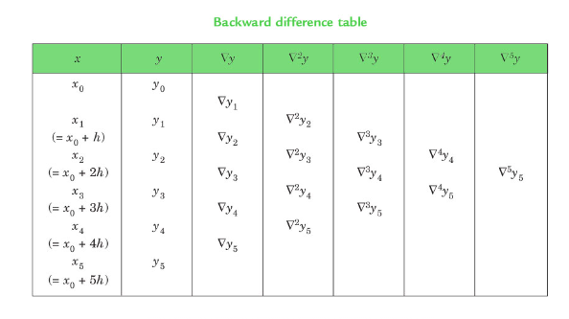

Slide 4
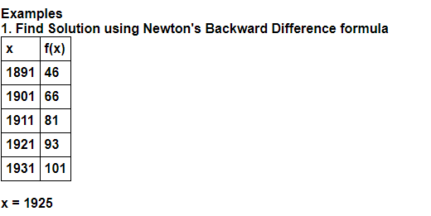
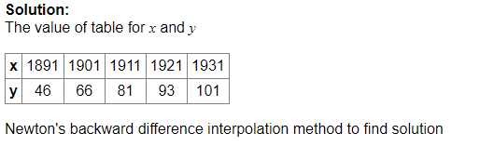
Example 1

Slide 5
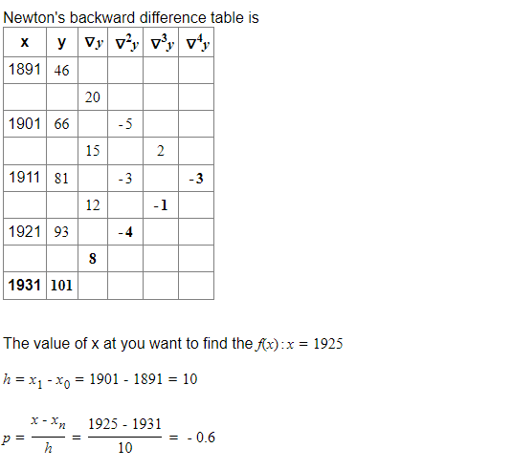

Slide 6
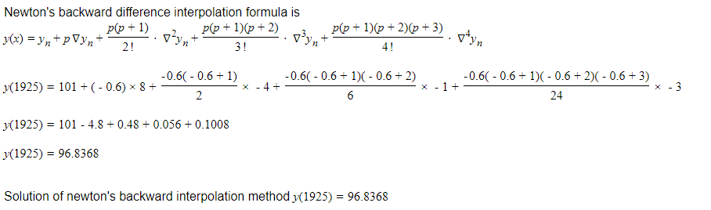

Slide 7
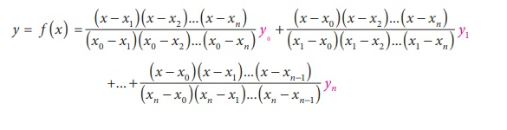
Lagrange's Interpolation
The Lagrange interpolation formula is a way to find a polynomial, called a Lagrange polynomial, that takes on certain values at arbitrary points. Lagrange’s interpolation is an Nth-degree polynomial approximation to f(x).
This formula is used to determine the function's value even when the parameters are not evenly spaced.

Slide 8
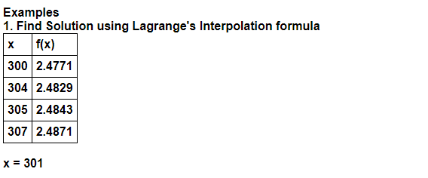
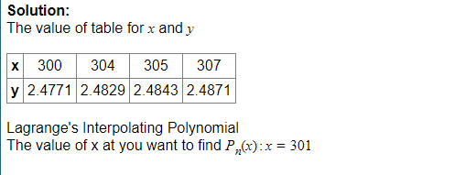

Slide 9
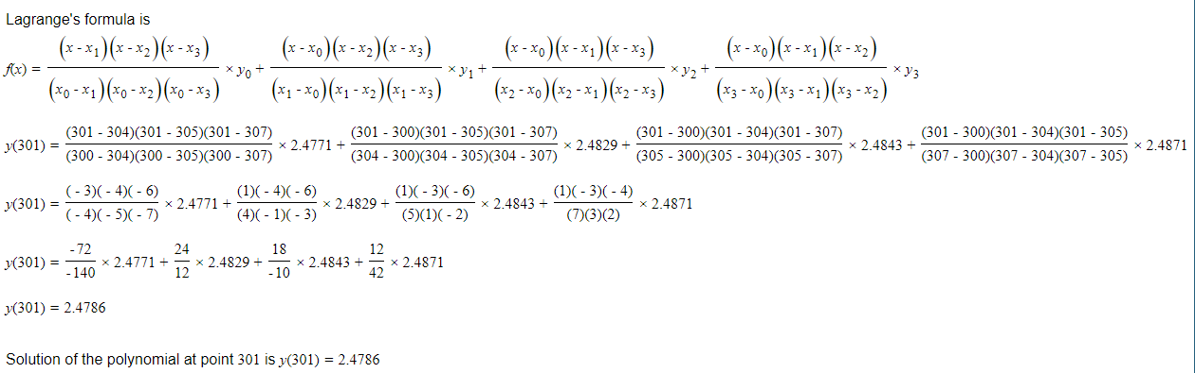

Slide 10
Exercises
Find the annual premium at the age of 33 from a table and construct a difference table and interpolate the value of f(x) :
Using Lagrange’s interpolation formula find y(10) from the following table:
Age in years | 24 | 28 | 32 | 36 | 40
Annual premium in Rs | 28.06 | 30.19 | 32.75 | 34.94 | 40
x | 5 | 6 | 9 | 11
f(x) | 12 | 13 | 14 | 16

